Slide 1
Java Packages

Slide 2
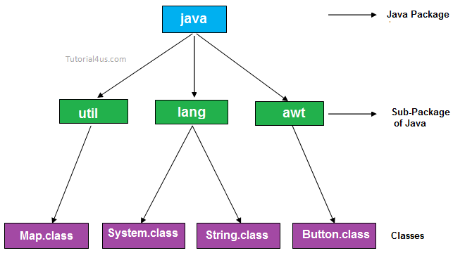
Java Packages

Slide 3
Java Packages
Packages in Java is a mechanism to encapsulate a group of classes, interfaces and sub packages.
Many implementations of Java use a hierarchical file system to manage source and class files. It is easy to organize class files into packages.
All we need to do is put related class files in the same directory, give the directory a name that relates to the purpose of the classes, and add a line to the top of each class file that declares the package name, which is the same as the directory name where they reside.

Slide 4
What Is a Package?
Package is a collection of classes , methods , interfaces. Packages contain sub packages
This statement should be used in the beginning of the program to include that program in that particular package.
package <package name>;
also. In java awt , util, swing, io, net packages are available.

Slide 5
Types of packages
Built-in package:
The already defined package like
java.io.*,
java.lang.*
etc are known as built-in packages.
User defined package:
The package we create is called user-defined package.

Slide 6
Built-in Packages
These packages consists of a large number of classes which are a part of Java API. For e.g, we have used java.io package previously which contain classes to support input / output operations in Java. Similarly, there are other packages which provides different functionality.
Some of the commonly used built-in packages are shown in the table below :
Java.io
Java.long
Java.util.scanner

Slide 8
Package Name | Description
java.lang | Contains language support classes ( for e.g classes which defines primitive data types, math operations, etc.) . This package is automatically imported.
java.io | Contains classes for supporting input / output operations.
java.util | Contains utility classes which implement data structures like Linked List, Hash Table, Dictionary, etc and support for Date / Time operations.
java.applet | Contains classes for creating Applets.
java.awt | Contains classes for implementing the components of graphical user interface ( like buttons, menus, etc. ).
java.net | Contains classes for supporting networking operations.

Slide 9
User-defined Packages
The package we create is called user-defined package.
we want to create a package named relational which contains a class named Compare. First, we will create a directory named relational ( the name should be same as the name of the package ). Then create the Compare class with the first statement being package relational;. Now, the package is ready to be imported. Following program shows the creation and use of Compare class.

Slide 10
Rules For naming Packages
1= Unique
2= LowerCase

Slide 11
Advantages of using a package
Reusability: Reusability of code is one of the most important requirements in the software industry.
Reusability saves time, effort and also ensures consistency.
A class once developed can be reused by any number of programs wishing to incorporate the class in that particular program.

Slide 12
Advantages of using a package
Access Control
Same classes name
In real life situation there may arise scenarios where we need to define files of the same name. This may lead to “name-space collisions”. Packages are a way of avoiding “name-space collisions”.

Slide 13
Accessing Packages
Fully Qualified Class Name
Import Statement

Slide 14
Fully Qualified Class Name
pack.A obj = new pack.A();
Java.awt.color

Slide 15
import Statement
Import Package name.*;
Import package name . class name;
Import java.util.Scanner;

Slide 16
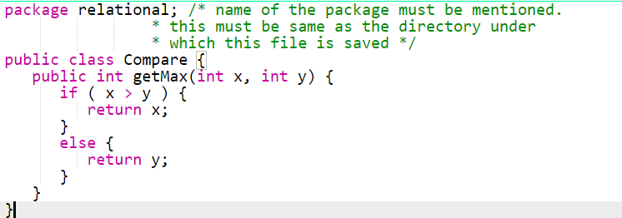

Slide 17
Steps of creating User Defined Packages Java and using them.
Create a package with a .class file
set the classpath from the directory from which you would like to access. It may be in a different drive and directory. Let us call it as a target directory.
Write a program and use the file from the package.

Slide 18
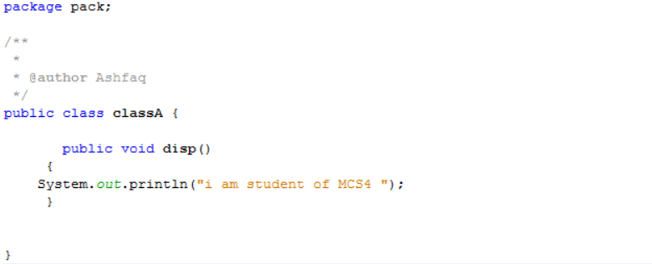
Create a User-Defined Packages

Slide 19
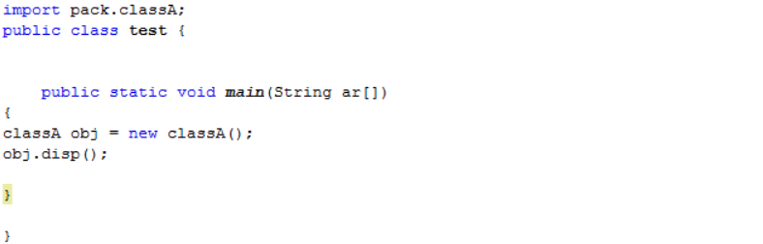
Compile

Slide 20
Creating a Nested Packages in Java
Package pack1.pack2;
Public Class test
{
Public Void show()
{
System.out.println("show metod ");
}
}

Slide 21
Compile
Importing Nested Packages in java
import pack1.pack2.test;
Class Main
{
Public Static Void main(String ar[])
{
test obj = new test();
obj.show();
}
}

Slide 22
Package pack1;
Public Class classA
{
Public Void disp
{
System.out.println("i am student of MCS4 ");
}
}

Slide 23
import pack1.ClassA;
Class Test
{
Public Static Void main(String ar[])
{
ClassA obj = new ClassA();
obj.dispA();
}

